Slide 1
Data Preprocessing

Slide 2
Typical Data Science Cycle
Data Collection
Business Insights & Understanding
Data Understanding
Model Building & Evaluation
Data Pre-Processing

Slide 3
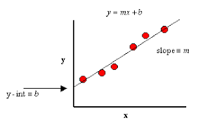
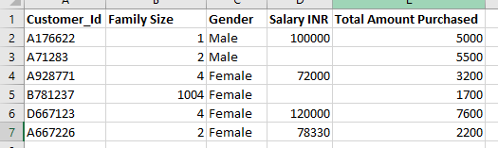
Data Preprocessing
Poor model on good data is likely to be better than great model on
poor data (noisy, incomplete and inconsistent)
Data preprocessing is a step of machine learning project where we convert
raw data in a
useful and efficient format
What do we want after pre-processing?
–Numeric: Complete, normally distributed, similar range, no noise
–Categorical: Complete, fewer levels where all levels with sufficient data

Slide 4
Data Preprocessing
There are 3 major processes in this steps :
Data Cleaning
Data Transformation
Data Reduction

Slide 5
Data Preprocessing
Missing Value Treatment
Data Cleaning
Outlier Treatment
Others (Duplicates Removal)
Scaling
Data Transformation
Feature Selection
Data Preprocessing
Feature Creation (Aggregation and Discretization)
PCA
Dimension Reduction
Chi square

Slide 6
Data Preprocessing Of Unstructured Data
Convert Unstructured Data Into Structured Data
Text Data
Word to Document Matrix, Word embedding
Image Data
Creating feature maps using pixel information
Audio Data
Frequency , Time , Amplitude etc

Slide 7
Data Transformation

Slide 8
Data Transformation
Data Scaling: scaled to fall within a small, specified range.
Logarithmic transformation
min-max scaling (normalization)
z-score scaling (standardization)

Slide 9
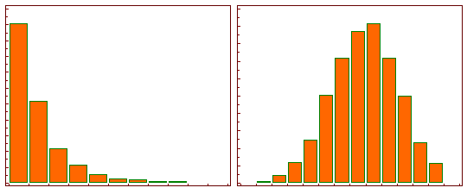

Data Transformation
Logarithmic transformation
What if we require to transform data into normal distribution to fulfill assumptions of algorithms.
Logarithmic transformation : log(x) of the data (Derived from Box-Cox power transformation)
When λ = 0 for normalization

Slide 10
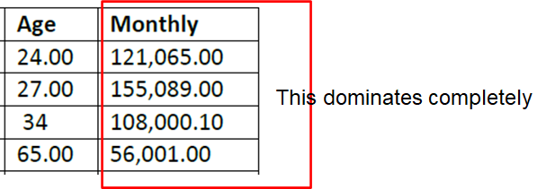
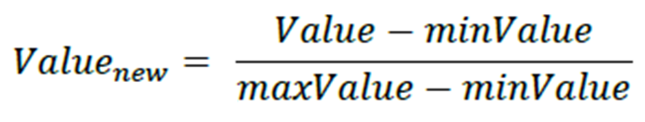
Data Transformation
Min Max Scaling (normalization)
Let us say, we are measuring distance between records for some purpose (Same application for z transformation).
Scaling is important in the algorithms such as support vector machines (SVM) and k-nearest neighbors (KNN) where distance between the data points is important.
For every feature, the minimum value of that feature gets transformed into a 0, the maximum value gets transformed into a 1, and every other value gets transformed into a decimal between 0 and 1.
Min-Max is extremely sensitive to the outliers.

Slide 11
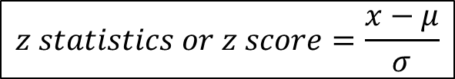
Data Transformation
z-score scaling (standardization)
Let us say, we are measuring distance between records for some purpose
Its mean is zero and standard deviation is 1.
Standardization can be helpful in cases where the data follows a Gaussian distribution.
Handles outliers, but does not produce normalized data with the exact same scale like min-max scaling does. Standardization does not change the skew of the distribution but logarithmic transformation changes decreases skewness

